Slide 1
US Research University Prediction Model
Philip Gabriel Andrada

Slide 2




Notes:
Some high school students would want to get into the best universities in the world. Some of these universities are located in United States, like MIT, Yale, UC Berkley and Harvard. Question is: would there be chances of getting into these universities, aside from the SAT averages?

Slide 3
Objectives
Create a prediction model for a high school student to get into a research university in the United States
Determine the factors that would consider a student get into a research university
Predict a completion rate of an international student based on different factors affecting the student (SAT average, cost, etc.)
Notes:
Using the data from the College Scorecard, we could create some prediction models on the acceptance into research universities, and the rate of completion for an international student.

Slide 4
Supervised Learning Methods
Logistic/Linear Regression
Single Decision Tree
Random Forest
Support Vector Machine (SVM)
Simple Tree
Conditional Inference Tree
Notes:
There are different methods used in the research project. We used these methods, and check on their accuracy based on these methods used.

Slide 5
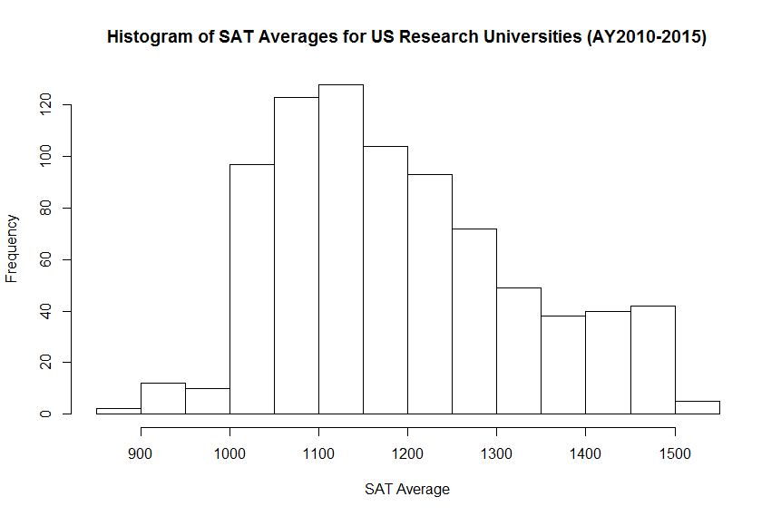

Slide 6
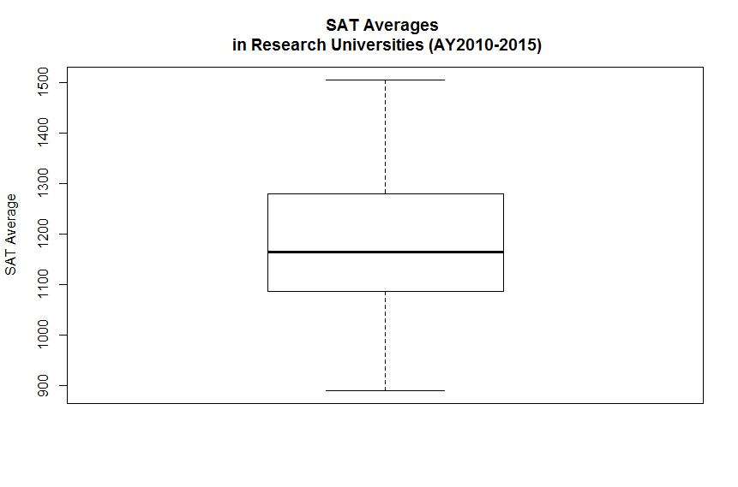

Slide 7
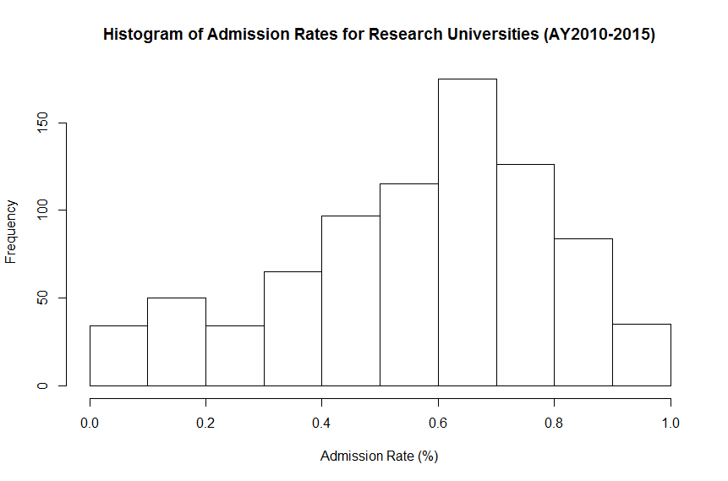

Slide 8
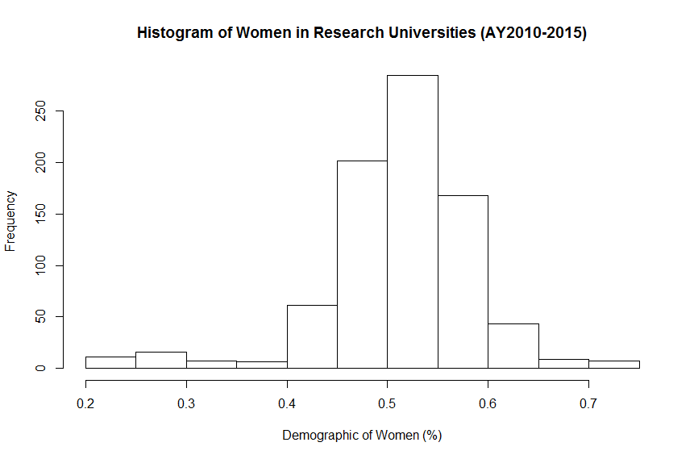

Slide 9
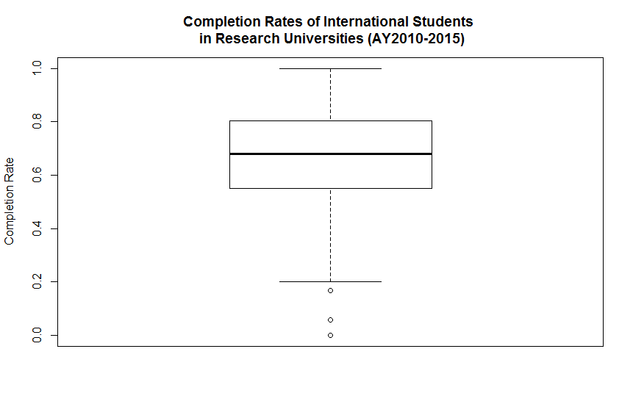
Notes:
There were a couple of outliers in the completion rates of international students. We did not remove these data, because there are some important information that is relevant on the study.

Slide 10
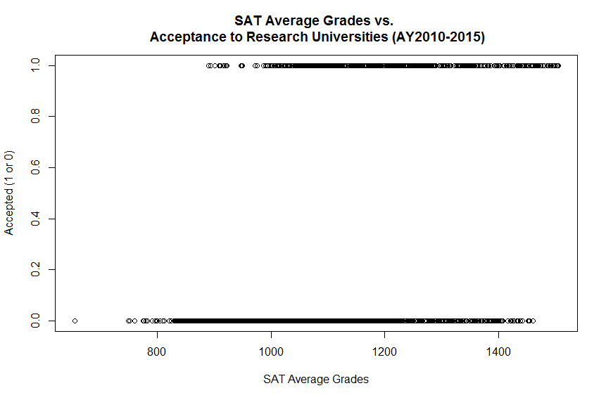

Slide 11
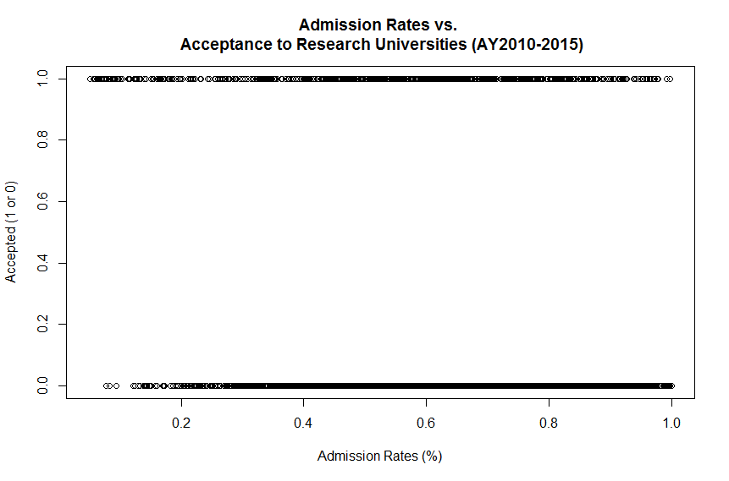

Slide 12
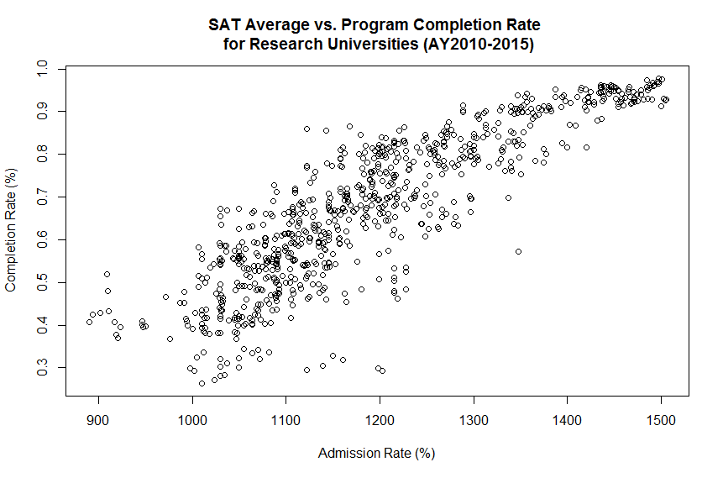
Notes:
The correlation coefficient is 87.02%. This means there is a strong positive correlation.

Slide 13
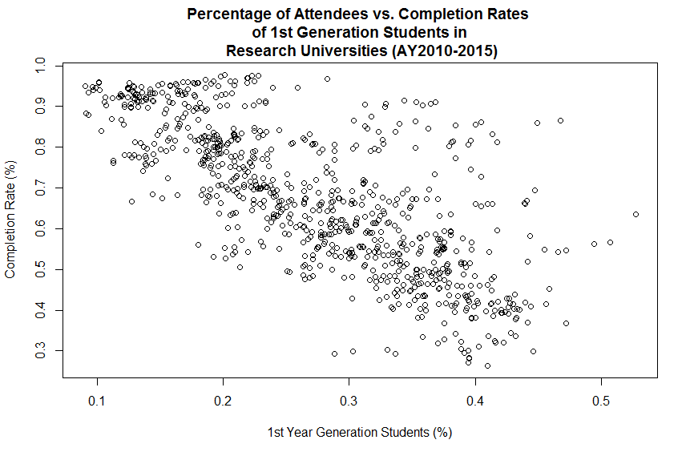
Notes:
The correlation coefficient is -74.19%. This means there is a strong negative correlation.

Slide 14
Results of US Research University Admission Prediction Model
Method | Accuracy | Precision | Recall
Logistic Regression | 84.84% | 72.05% | 44.34%
Single Decision Tree | 86.63% | 71.35% | 59.73%
Random Forest | 93.69% | 94.25% | 74.20%
Support Vector Model | 87.95% | 86.05% | 50.23%
Simple Tree | 86.63% | 71.35% | 59.73%
Conditional Inference Tree | 86.63% | 69.65% | 63.35%

Slide 15
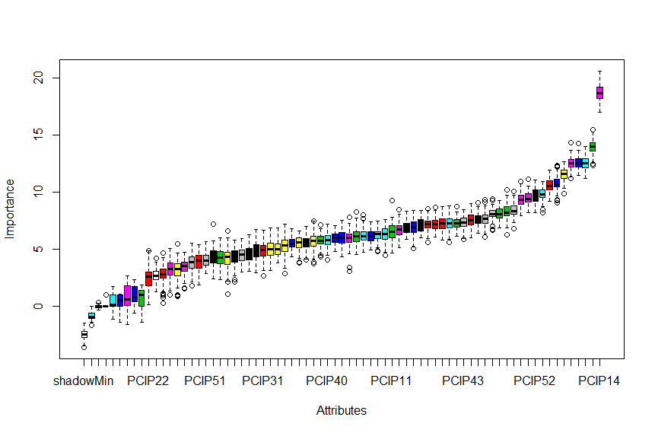
Variable Selection Using Boruta
Notes:
Based on the Boruta variable selection, 61 attributes confirmed important, 2 attributes are tentative, and 7 attributes are unimportant. In this graph, it shows what the importance of each attributes are in the variable selection.
The attributes that deemed important are as follows (from the run):
[1] "REGION" "ADM_RATE" "ADM_RATE_ALL" "SAT_AVG_ALL" "PCIP01" "PCIP03“
[7] "PCIP04" "PCIP05" "PCIP09" "PCIP11" "PCIP13" "PCIP14“
[13] "PCIP15" "PCIP16" "PCIP19" "PCIP23" "PCIP24" "PCIP26“
[19] "PCIP27" "PCIP30" "PCIP31" "PCIP38" "PCIP39" "PCIP40"
[25] "PCIP41" "PCIP42" "PCIP43" "PCIP44" "PCIP45" "PCIP49"
[31] "PCIP50" "PCIP51" "PCIP52" "PCIP54" "UGDS_WHITE" "UGDS_BLACK"
[37] "UGDS_HISP" "UGDS_ASIAN" "UGDS_AIAN" "UGDS_NHPI" "UGDS_2MOR" "UGDS_NRA"
[43] "UGDS_UNKN" "PPTUG_EF" "COSTT4_A" "TUITIONFEE_IN" "TUITIONFEE_OUT" "C150_4"
[49] "C150_4_WHITE" "C150_4_BLACK" "C150_4_HISP" "C150_4_ASIAN" "C150_4_AIAN" "C150_4_2MOR"
[55] "C150_4_NRA" "C150_4_UNKN" "RET_FT4" "PCTFLOAN" "PAR_ED_PCT_1STGEN" "UGDS_MEN"
[61] "UGDS_WOMEN"

Slide 16
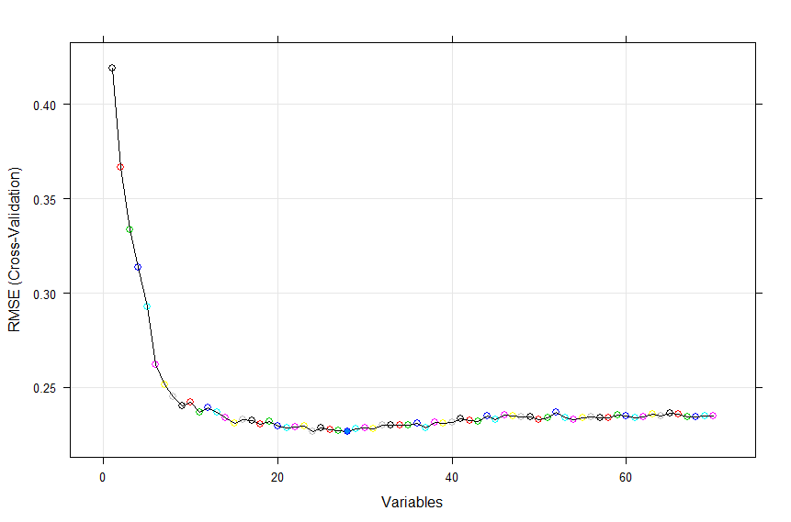
Variable Selection Using RFE
Notes:
There are 28 variables that could be used in the acceptance prediction model. From here, it shows that RFE uses less variables than Boruta.
The variables are as follows:
[1] "PCIP14" "PCTFLOAN" "PCIP04" "SAT_AVG_ALL" "PCIP52" "UGDS_BLACK" "UGDS_WOMEN" "UGDS_MEN“
[9] "PCIP45" "PCIP43" "COSTT4_A" "PCIP23" "UGDS_HISP" "TUITIONFEE_IN" "RET_FT4" "UGDS_ASIAN“
[17] "PCIP16" "PCIP39" "C150_4_AIAN" "C150_4" "UGDS_WHITE" "PCIP26" "PCIP03" "PCIP19“
[25] "UGDS_NRA" "PCIP24" "PCIP05" "PPTUG_EF"

Slide 17
Results of US Research University Completion Rate Prediction Model
Method | PRED(25)
Linear Regression | 80.88%
Single Decision Tree | 92.65%
Random Forest | 93.63%
Support Vector Model | 91.67%
Simple Tree | 92.16%
Conditional Inference Tree | 91.67%

Slide 18
Conclusion and Recommendations
The research determines the factors that could be used in predicting the acceptance and completion in research universities
Useful in understanding the acceptance of a high school student in the research university beyond SAT grades
Could use different variables as suggested by RFE and Boruta variable selection
Dig deeper into the use of different supervised learning methods

Slide 19
Thank You!

